Slide 1
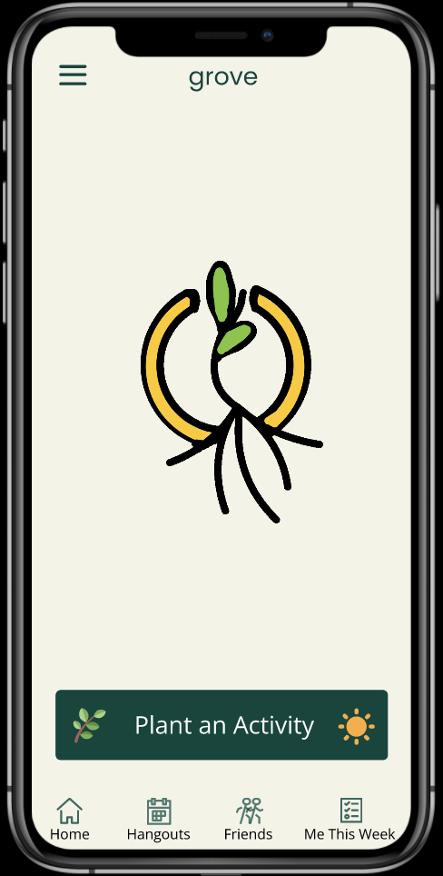
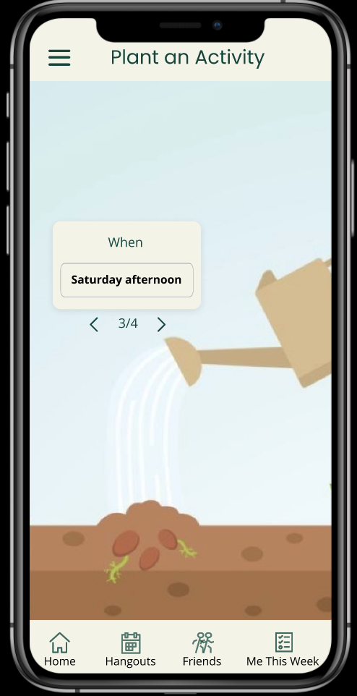
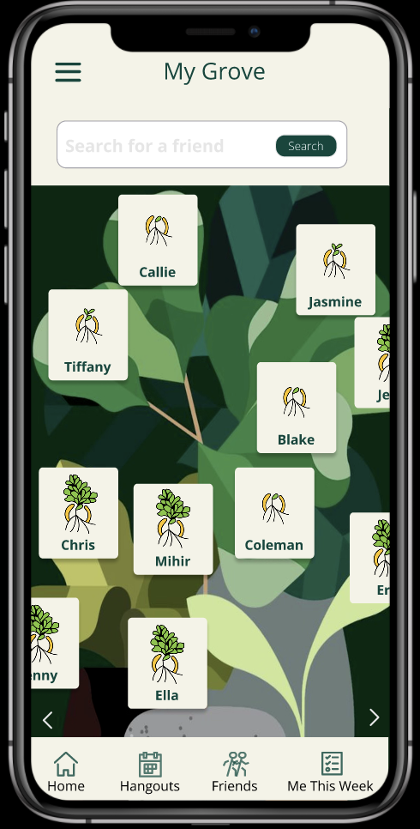
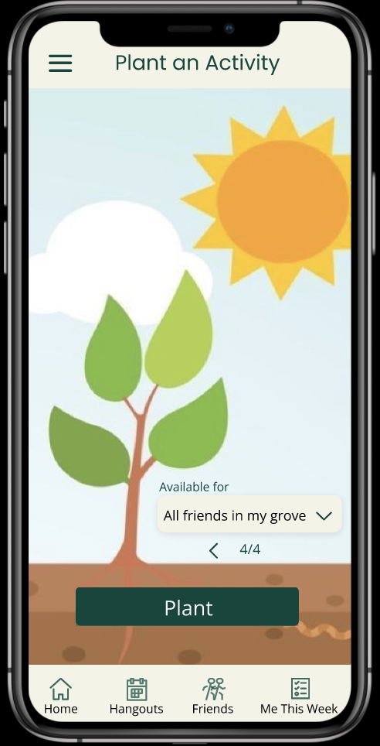
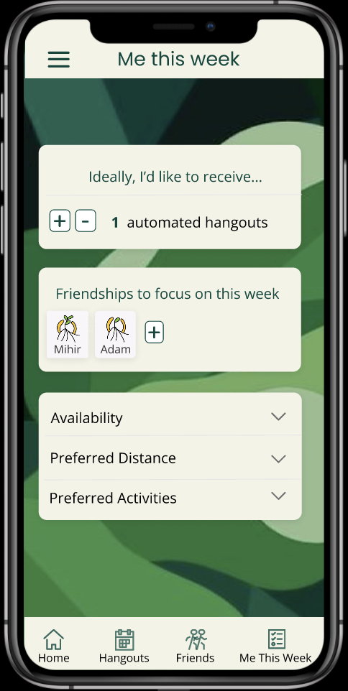
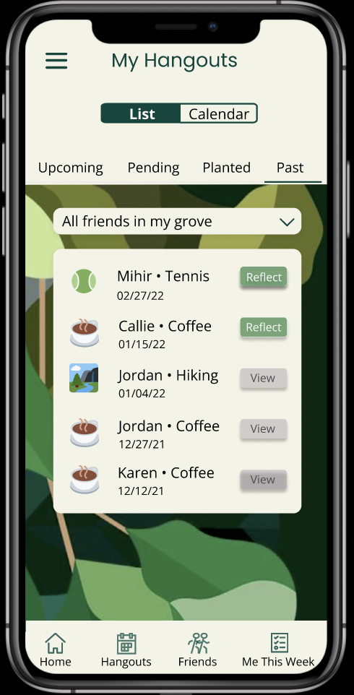
grove
Medium-fi Prototype
Amelia, Chris, Jasmine and Tiff

Slide 2
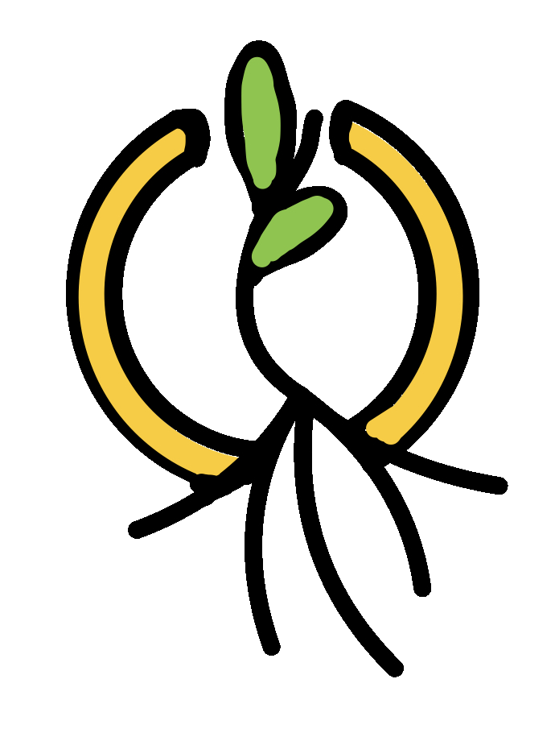
grove
Cultivate your post-grad community
Post-grads are faced with the often-overwhelming challenge of building and retaining friendships amidst a sea of new connections. Grove allows post-grads to focus on the enjoyable and exciting aspects of building community by simplifying the stressful aspects of inviting, planning, and following up with new friends. Grove helps ensure that new friendships deepen into lasting friendships without the anxiety that currently accompanies post-grad community building.

Slide 3
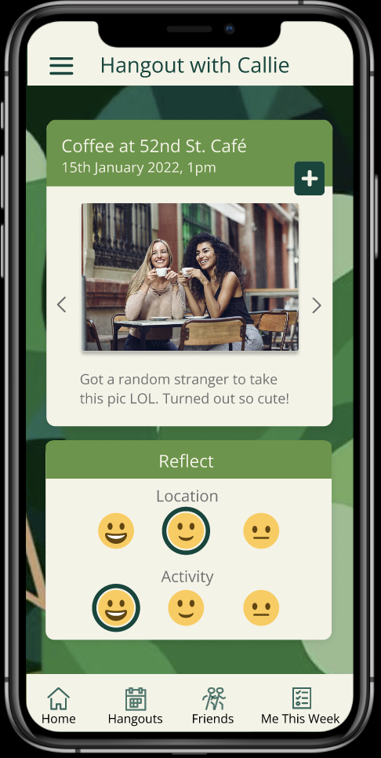
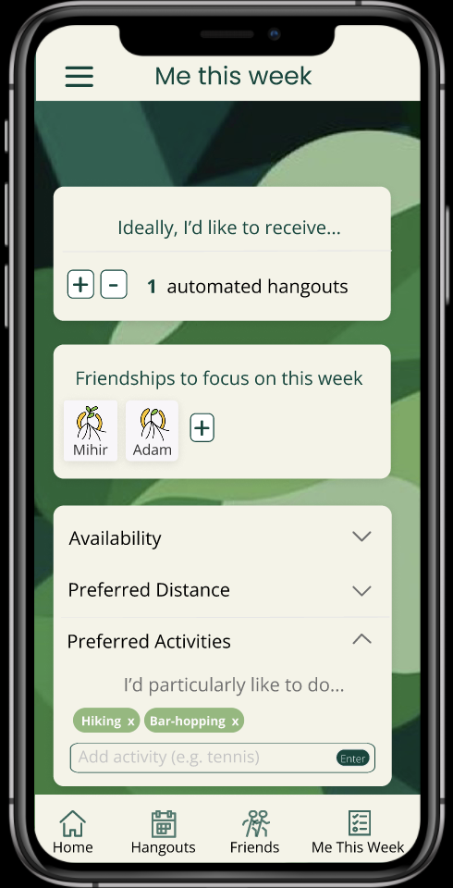
Values Encoded (1/2)
CONSISTENCY
AUTHENTICITY
PRIVACY
Embed consistency in following up on new friendships.
Be yourself as you enter a friendship and do activities that you will likely enjoy.
Being mindful of user data stored in the app and shared with others. Being clear on what data is being shared with friends.
Encourage growth of friendship with tree icon updated for more hangouts.
Prioritize activities that help you feel great and comfortable in your skin when hanging out.
Very few options to include information that you might not want other people to see. e.g. only explicitly reflect on location and activity of hangout, not on the interaction with other people.

Slide 4
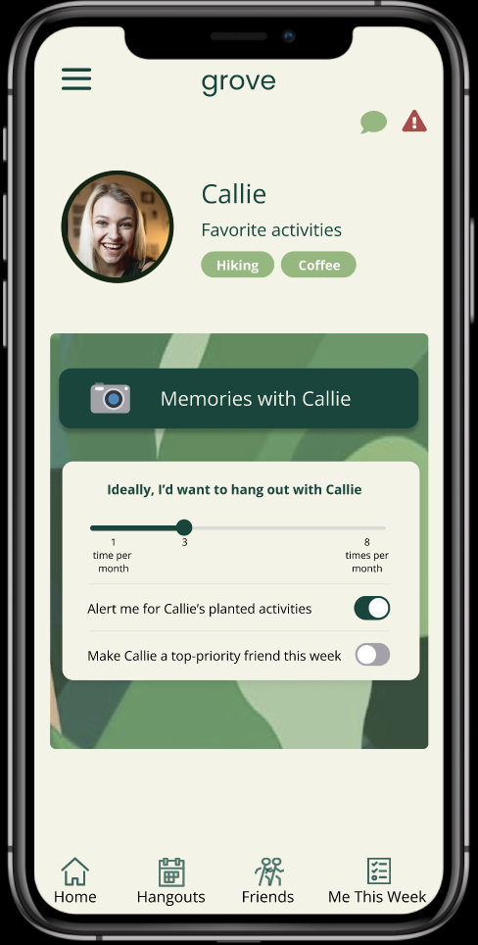
Values Encoded (2/2)
RESPECT
INTENTIONALITY
HEALTHY USE OF TECH
Respect new acquaintances and friends through meaningful contact and planning.
Reflect on and actively plan how you want to build a friendship.
Use technology to empower friendships but not be the sole form of interaction between each other.
Keeps things positive by only reflecting on location and activity and encouraging that addition of positive memories together.
Allow users to think about the friendships they want to intentionally grow this week. Choose to increase frequency of hangout options.
App actively encourages people to meet in person when safe as opposed to virtually.

Slide 5
Values Encoded: Potential Conflicts
01
02
RESPECT VS. CONSISTENCY
RESPECT VS. INTENTIONALITY
What if one person wants to hang out more often than another person?
Reflecting on a hangout might lead to over-analyzing friendship or being critical of a new friend.
Set expectation that 'ideally' hangouts will be made with a friend but not guaranteed
Have a block/report button if anyone is inappropriate
No explicit reflection on interaction in the app
Focus on positive memories from hangout

Slide 6

Usability Goals & Key Measurements
ROBUST
EFFICIENT
PROGRESS
LEARNABLE
PLEASING
Users able to complete all tasks with minimal error rate. Key measurement
Users able to complete all tasks under specified time range. Key measurement
Our low-fi fulfilled both the Robust and Efficient metrics, so we will keep most task flows we developed
To increase learnability, we will make buttons larger and more obvious
To make the design more pleasing, we will more creatively re-imagine a format for some tasks, e.g. planting an activity
Increasing familiarity with screens used in all tasks. Usability goal
Using show positive verbal / physical signs of excitement during use. Usability goal

Slide 7
TASKS
Set your weekly hangout preferences¹ and then accept a hangout that aligns with those preferences
Set your hangout preferences with a specific friend²
Plant an activity–post an activity that you want to do
Reflect on a hangout–upload photos, rate location/activity
SIMPLE
SIMPLE³
MEDIUM
COMPLEX
1. How often do you want to hangout across friends? 2. How often do you want to hangout with a specific friend?
3. Originally one of the medium tasks from the lo-fi prototype (around planning an intentional cadence of hangouts with an individual), but was simplified following interviewee and studio feedback on lo-fi prototype (so is now a simple task)

Slide 8
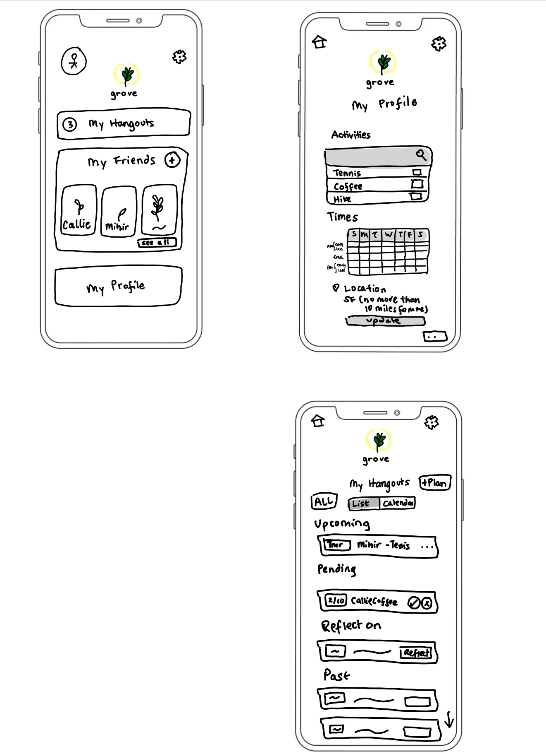
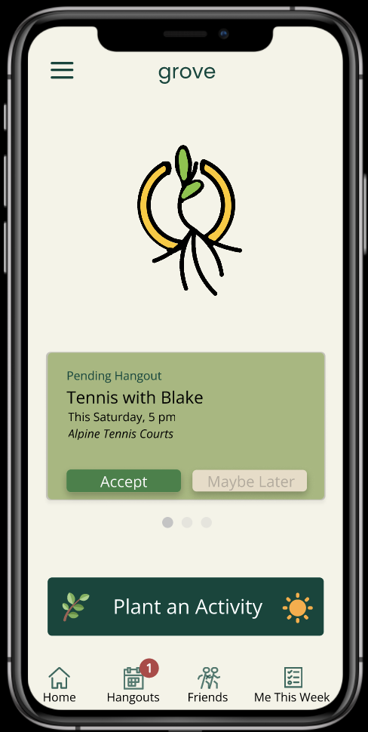
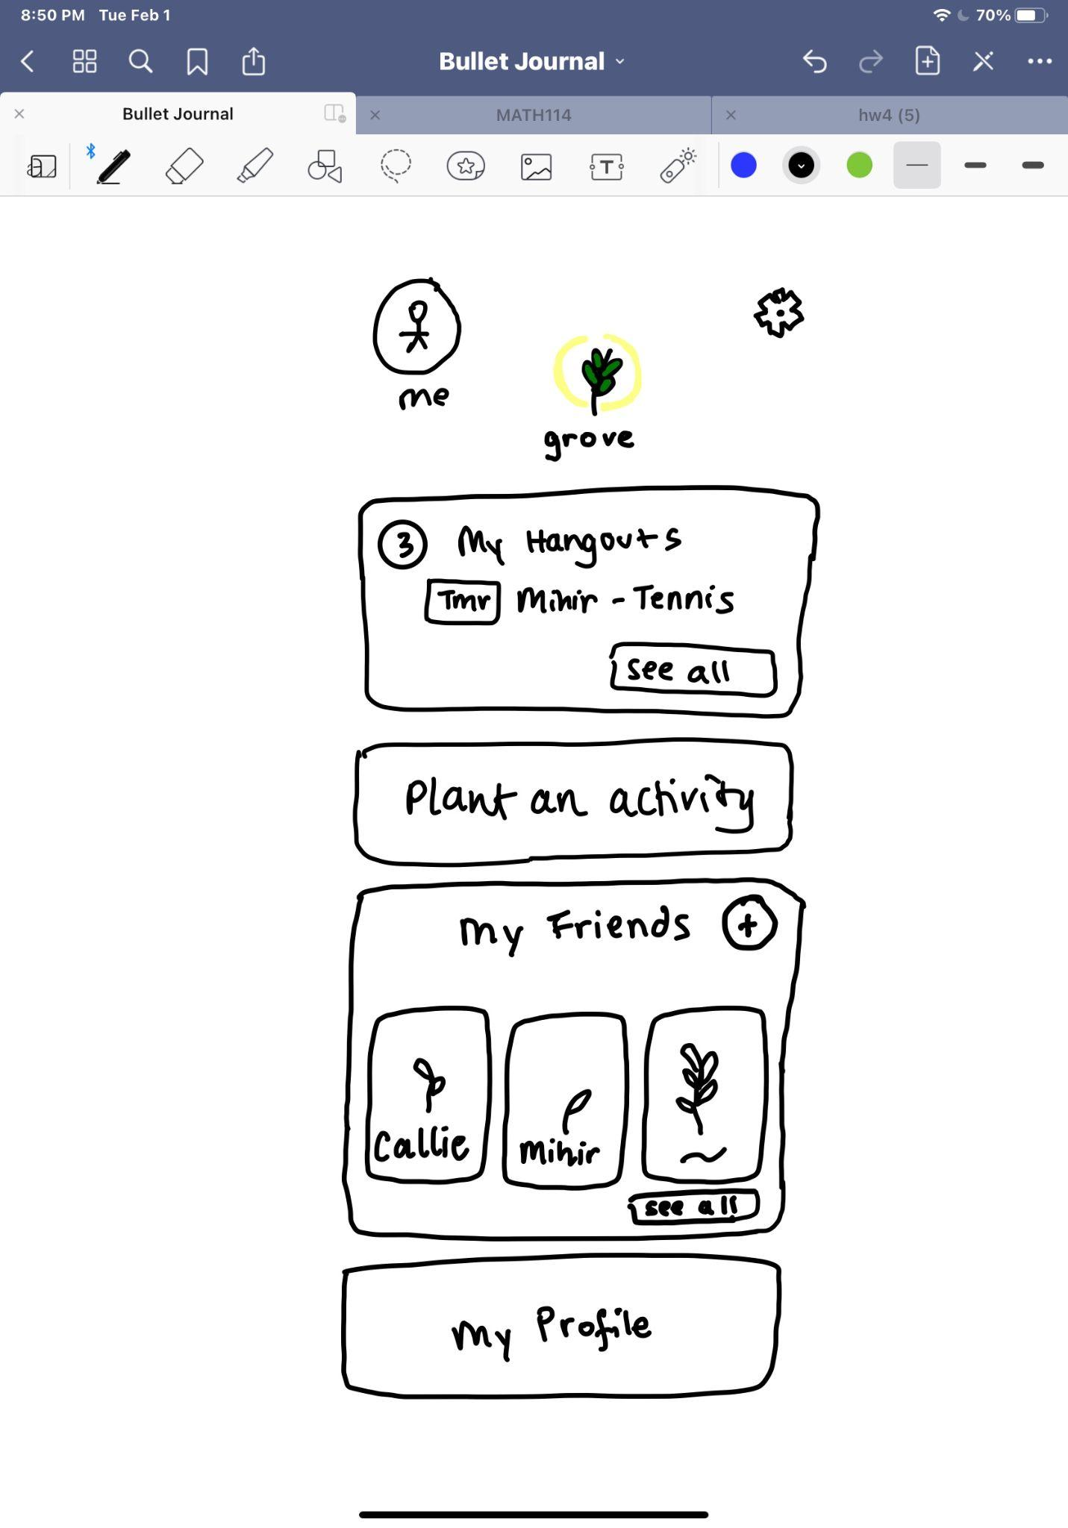
Major Design Change #1
Homescreen

Slide 9
Homescreen
Confusing settings
Confusion between static vs. dynamic settings, friend vs. personal settings
New static settings
Added static settings sidebar access in the top left corner available on all pages
New bottom bar
Moved dynamic settings to bottom bar for easy access, deleted all other setting navigation from homepage
Cluttered screen
Too many things on the screen, unclear what user actions are most important
Simple layout
Simplified homepage to highlight most important user actions: accept/decline pending activities, plant an activity

Slide 10
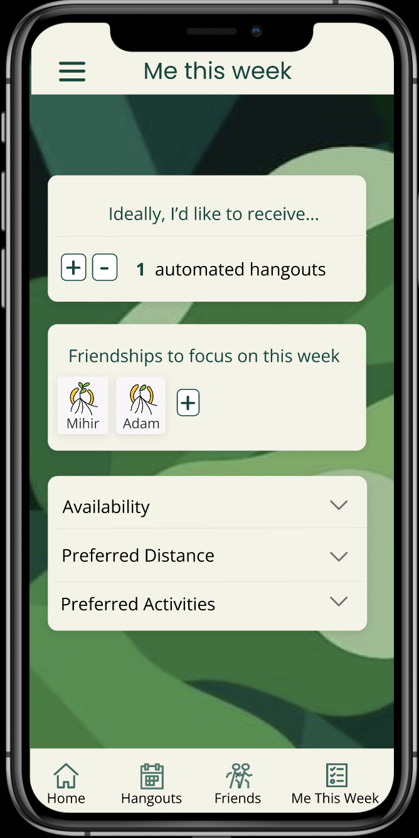
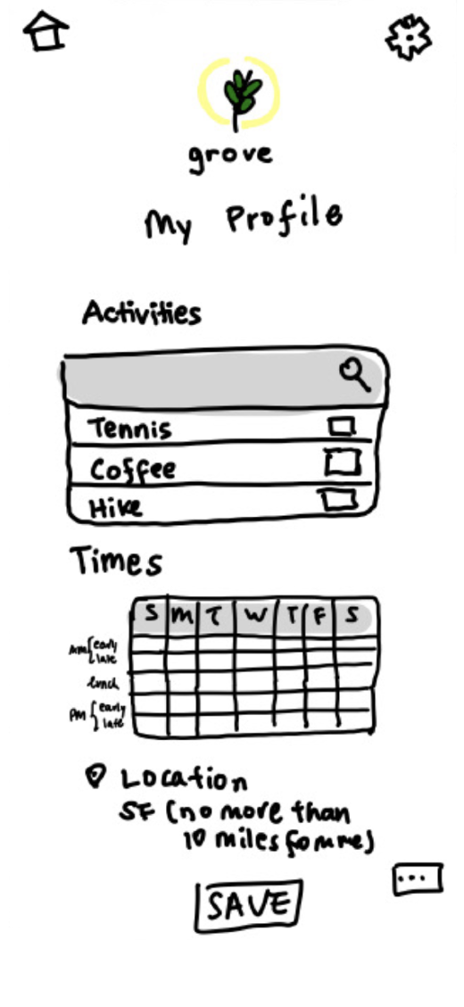
Major Design Change #2
Dynamic profile
screen
(i.e. where you set information about your preferences for automated hangouts in a week)

Slide 11
Profile Screen
Cluttered screen
Too many actions to do in one screen
New “Me this week”
New simplified screen to update dynamic preferences for the week. Popups added for actually changing preferences to declutter main screen
Confusing name
“My profile” seems to imply static settings, things that you input when you first create an account, while preferences for hangouts are more dynamic–likely to be updated more frequently by users
Personal settings
New “Me this week” page contributes to new clear differentiation between personal and friend settings–global frequency is a personal setting (how many hangouts do you want across your friends), while hangout frequency with a particular person is a friend setting

Slide 12
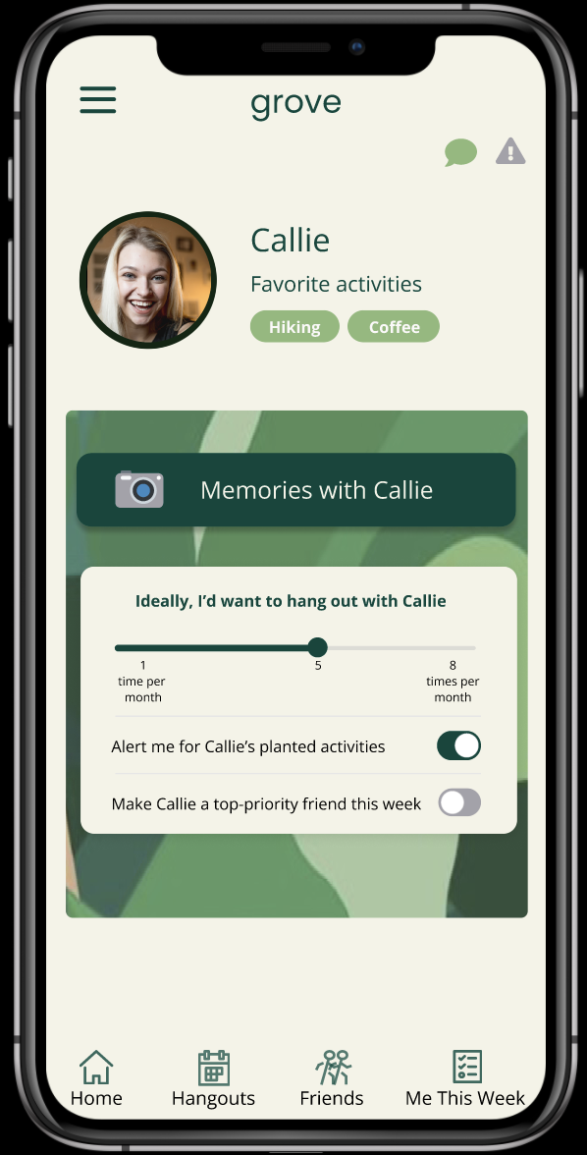
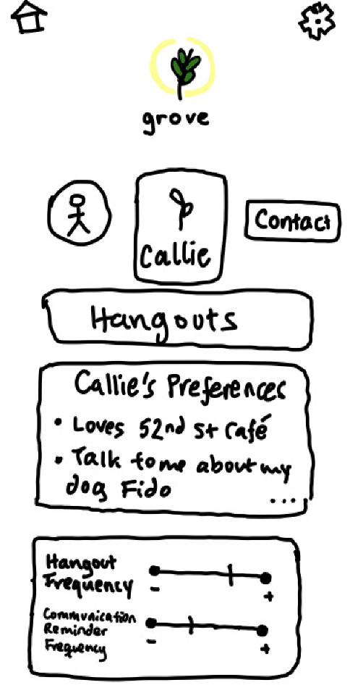
Major Design Change #3
Friend Screen

Slide 13
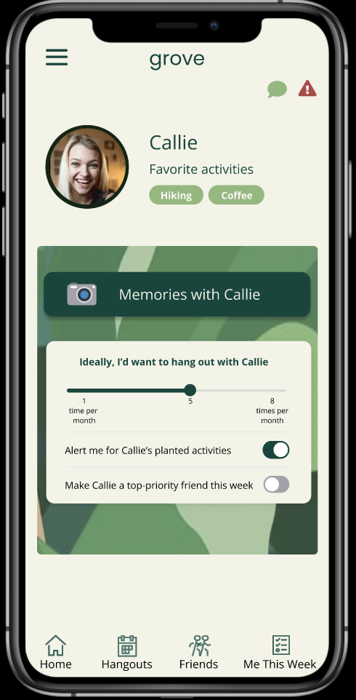
Friend Screen
Confusing language
“Frequency of communication” not intuitive–what does it mean to “increase frequency” with a friend? How does that contribute to deepening the friendship?
Simple frequency
Simplified interface and clearer language for setting frequency preferences–set number of times you want to hang out with a particular person

Slide 14
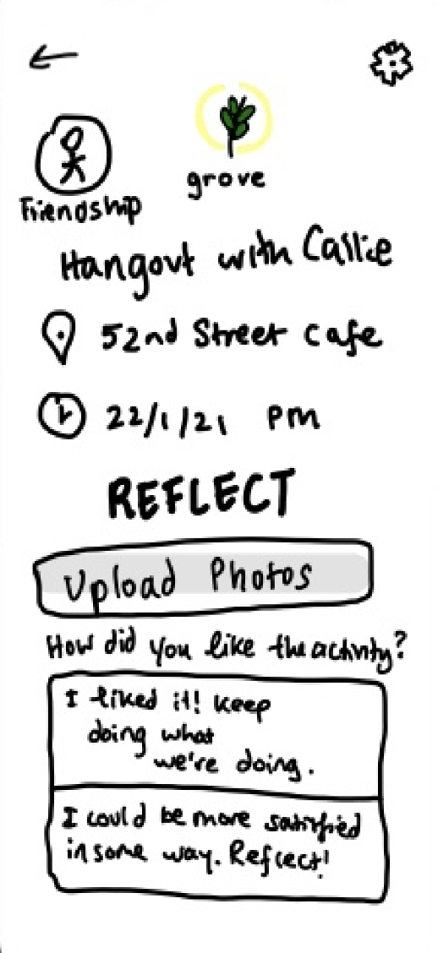
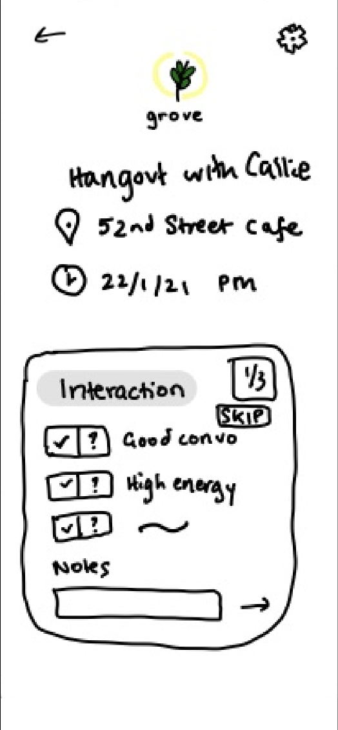
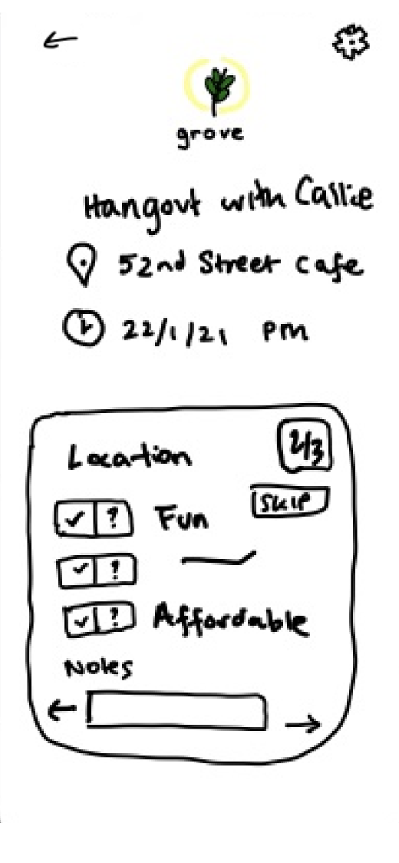
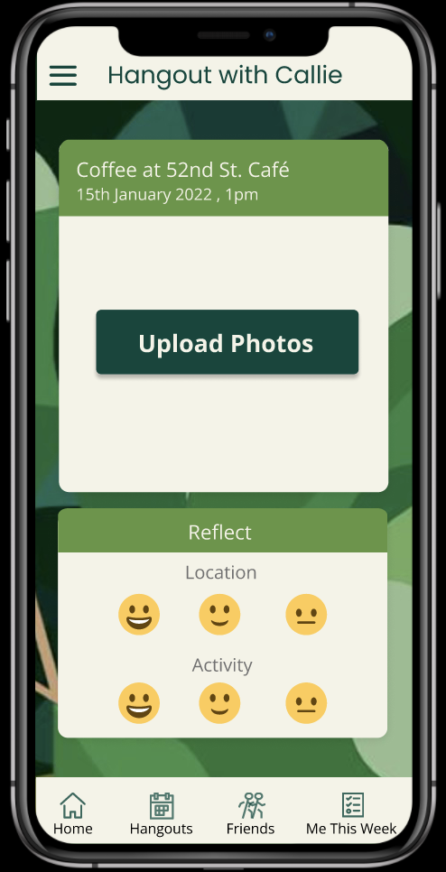
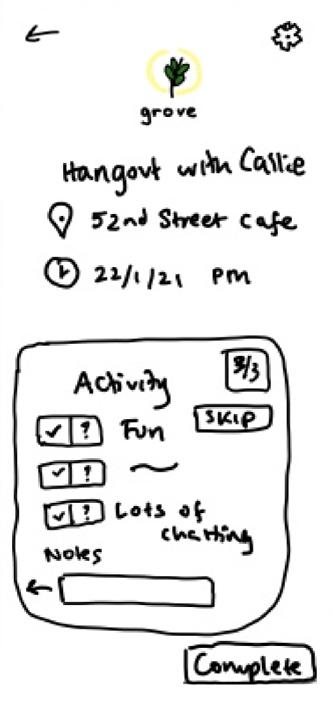
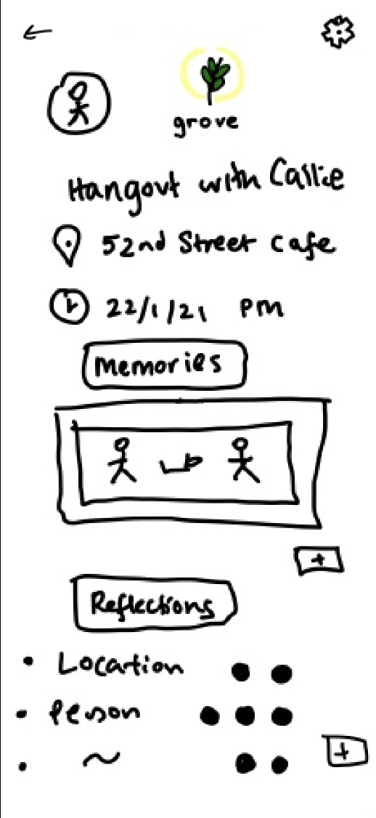
Major Design Change #4
Hangout
Reflection

Slide 15
Hangout Reflection (1/2)
Anonymous?
Unclear if reflection on a hangout was going to be seen by your friend; worried friend would find out user didn’t like the hangout
No friend reflection
Removed all aspects of reflecting on an individual person entirely besides uploading pictures of the activity; idea is to encourage the positive sharing of memories rather than overthinking a hangout
Uncomfortable
Being forced to analyze a hangout may be detrimental to a friendship–if a hangout wasn’t perfect, that doesn’t mean that this friendship wouldn’t work out

Slide 16
Hangout Reflection (2/2)
Too many screens
Reflection task took too long–made the activity feel high stakes and users were unsure about how the information would be used to influence future hangouts
Less tasks
Users only reflect on the location of the hangout and the activity
Too many tasks
Too many things to reflect on made the task of reflecting on a hangout laborious
Emotion reflection
Users reflect on the overall activity based on their emotions–lower stakes than saying definitively that they did or did not like the hangout

Slide 17
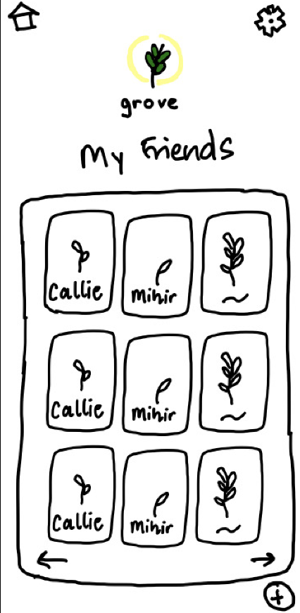
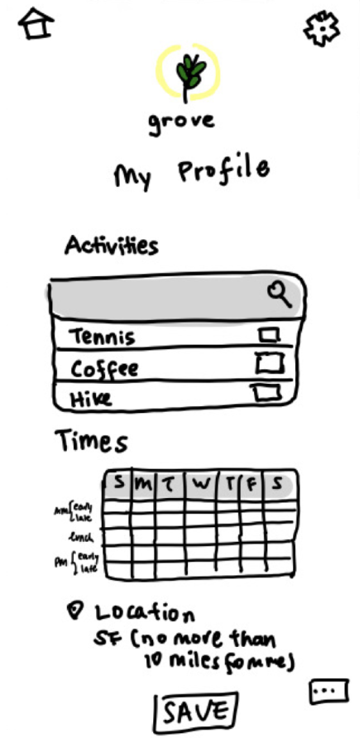
Major Design Change #5
My Grove

Slide 18
My Grove
Boring layout
Screen was too boxy, more room for creativity in displaying all of the friends at once
New layout
Worked to come up with a more creative layout that was less grid-like; friends are leaves in a giant plant–continuing plant metaphor

Slide 19
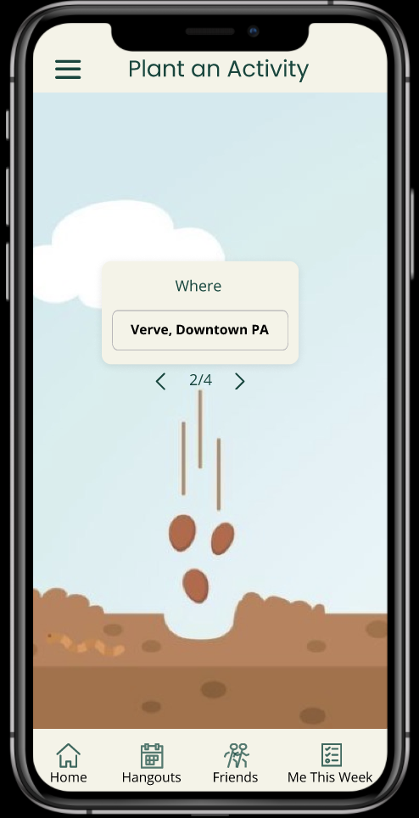
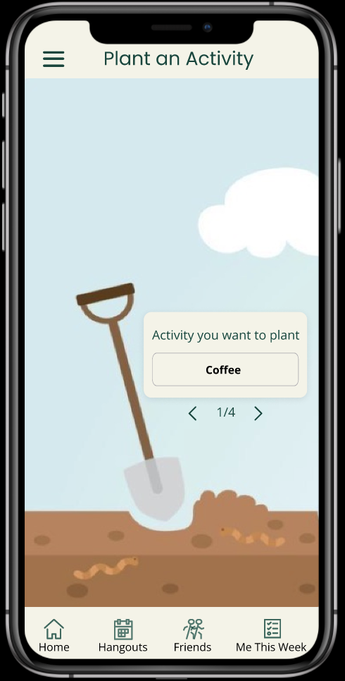
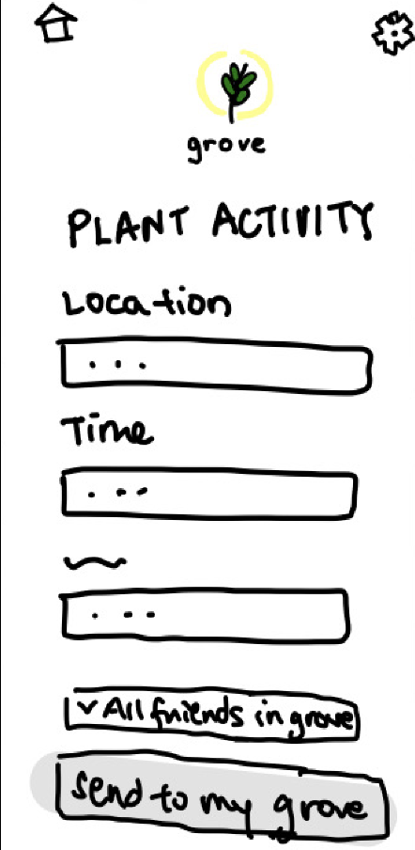
Major Design Change #6
Plant an Activity

Slide 20
Plant an Activity
Boring design
Screen was too Google form-like, more room for creativity and playing on the plant metaphor in visual layout
New visuals
Worked to come up with a more creative layout that was less form-like; played on plant metaphor by making each step of the process of creating an activity a step in the process of planting a plant

Slide 21
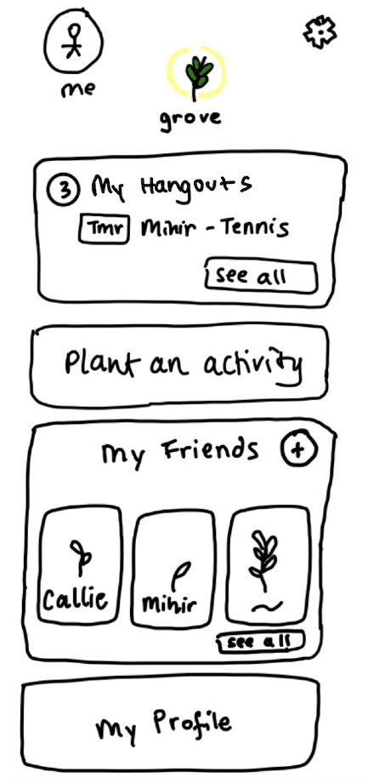
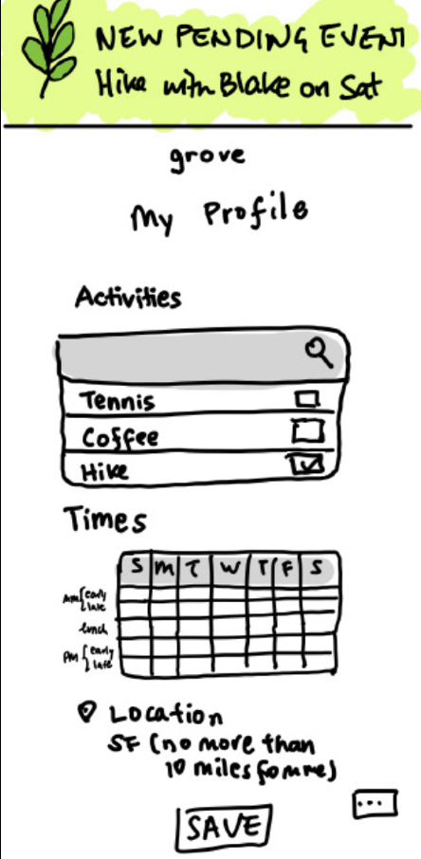
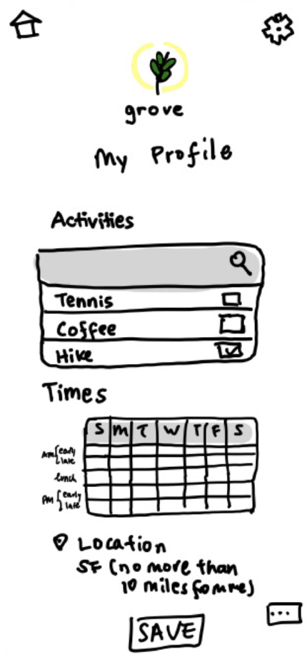
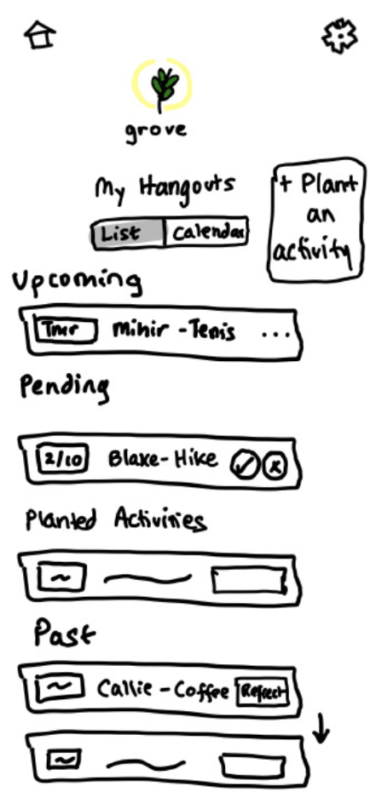
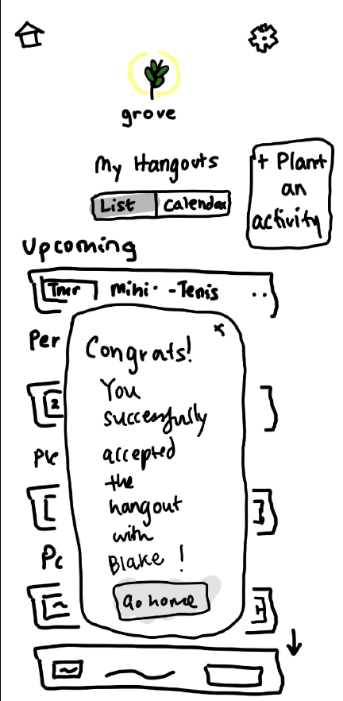
Task #1: Set Preferences→Accept Hangout

Slide 22
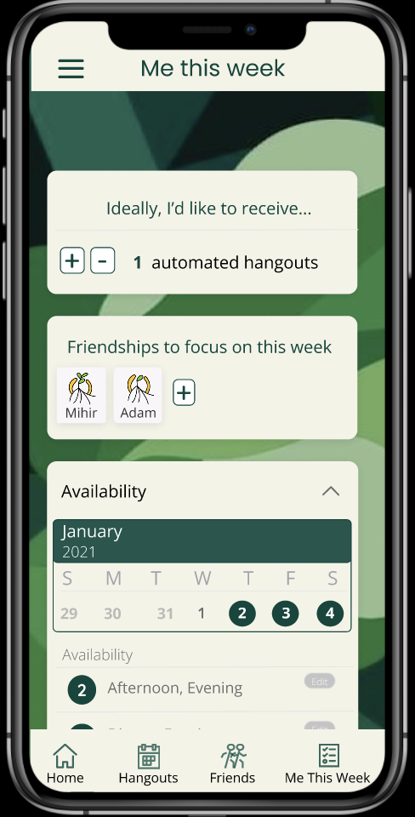
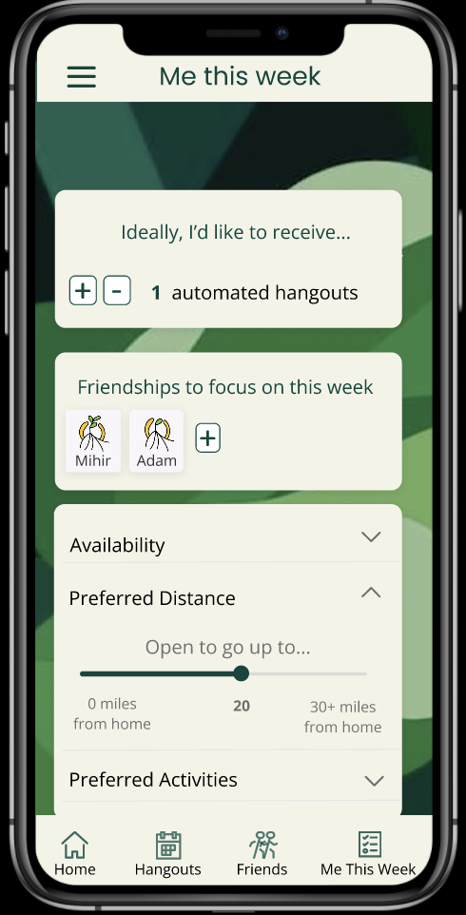
Task #1: Set Preferences→Accept Hangout (1/2)

Slide 23
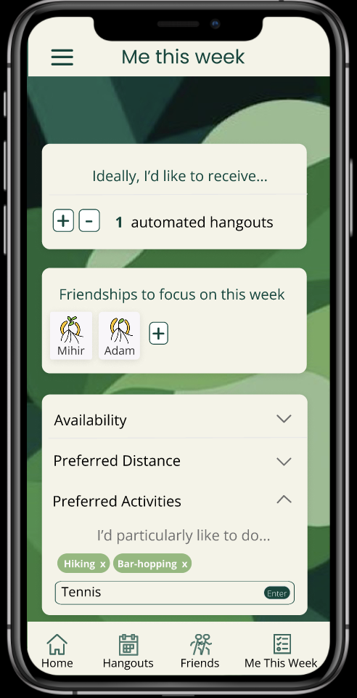
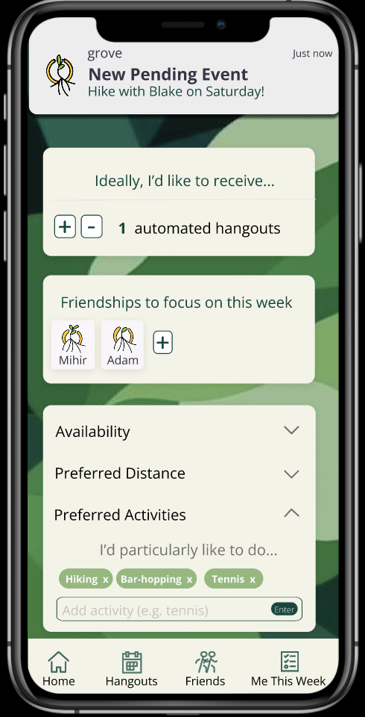
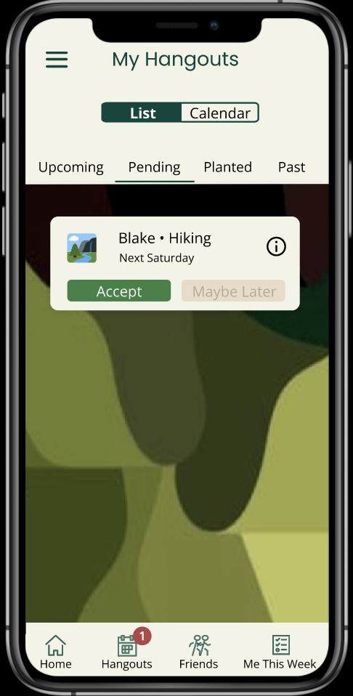
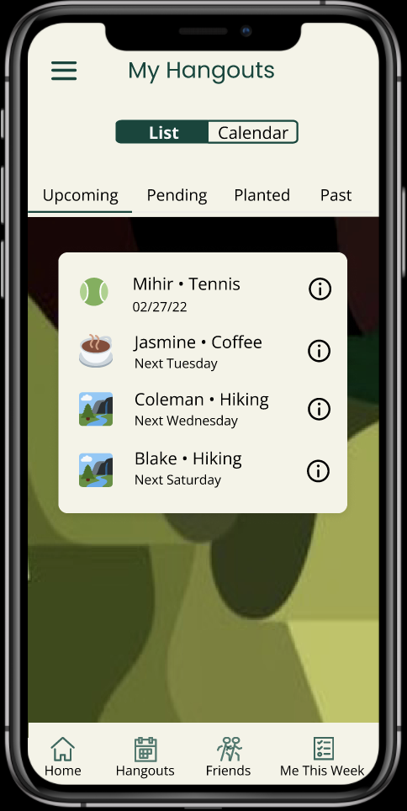
Task #1: Set Preferences→Accept Hangout (2/2)

Slide 24
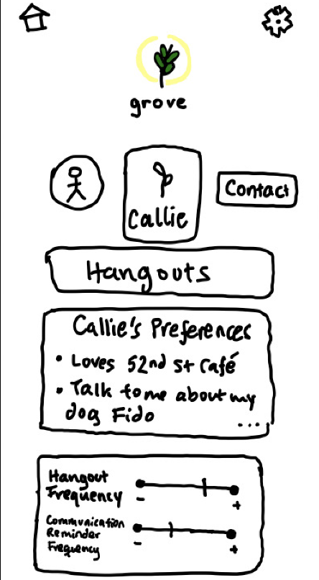
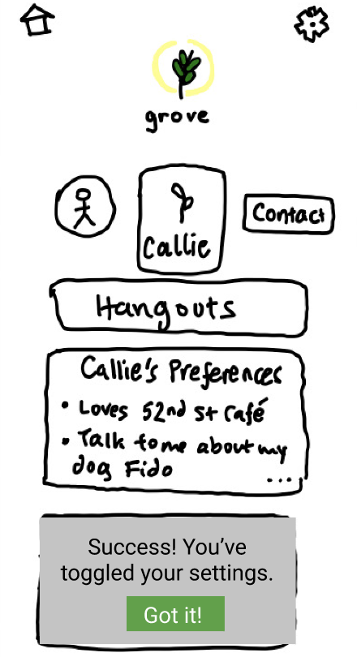
Task #2: Set Hangout Preferences (Friend)

Slide 25
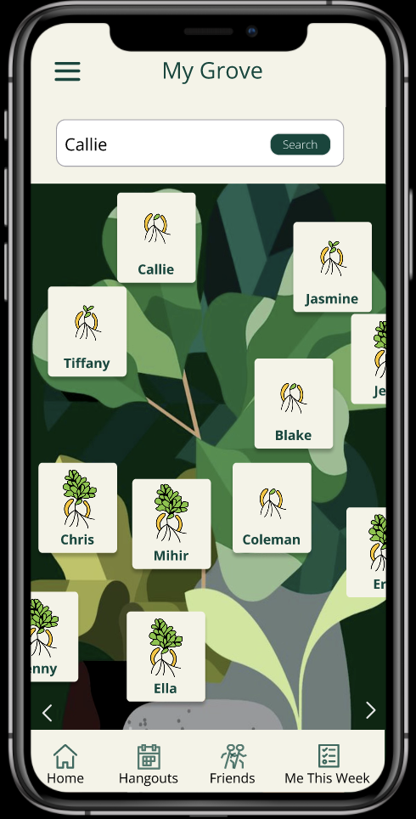
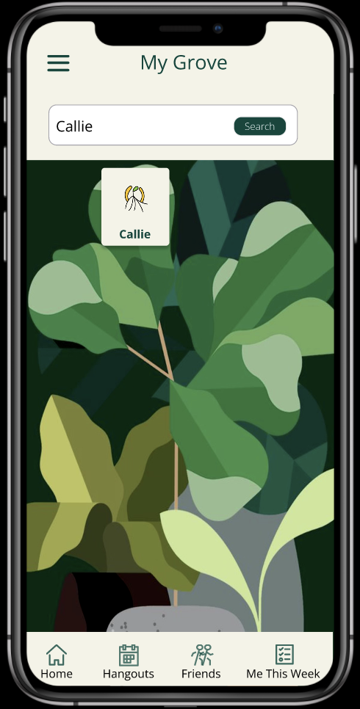
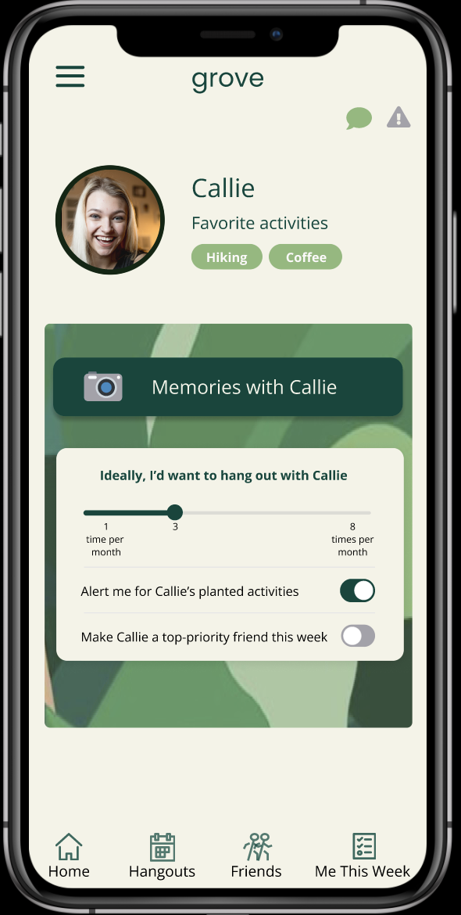
Task #2: Set Hangout Preferences (Friend)

Slide 26
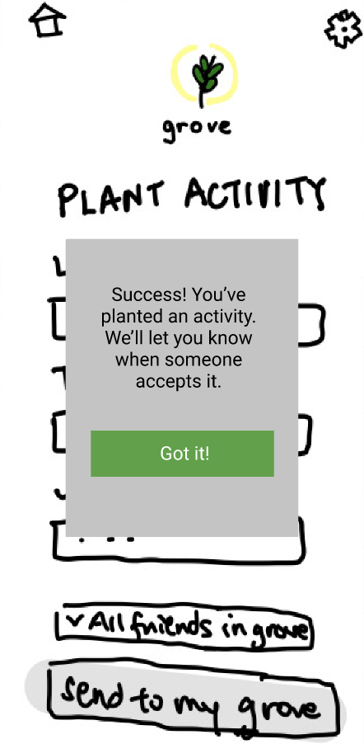
Task #3: Plant an activity

Slide 27
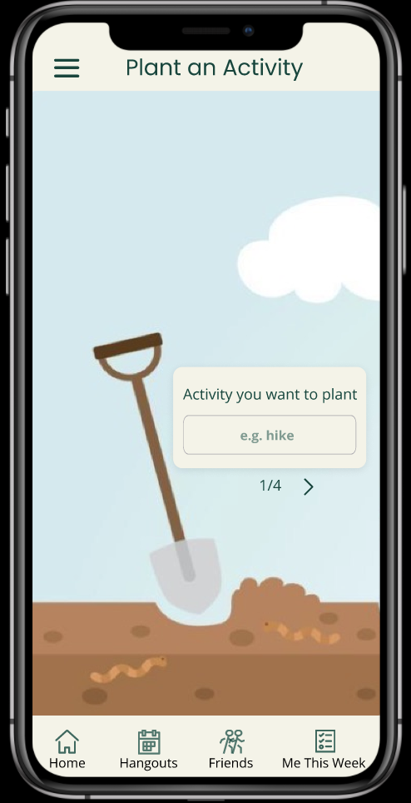
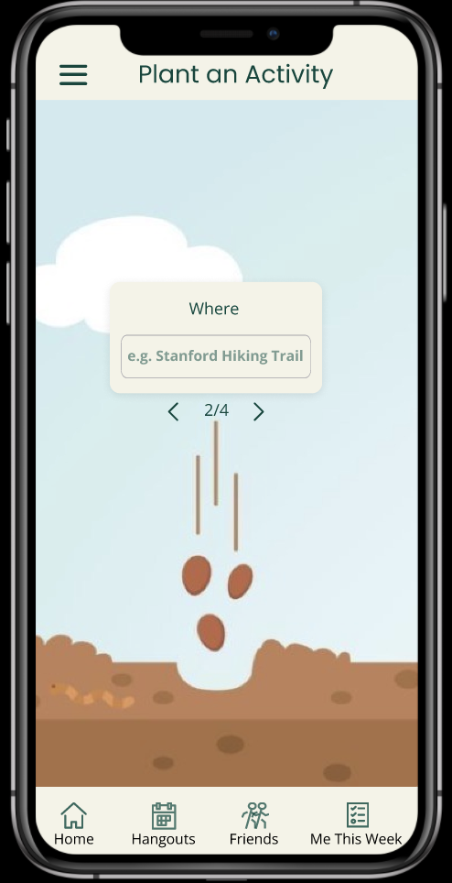
Task #3: Plant an Activity (1/2)

Slide 28
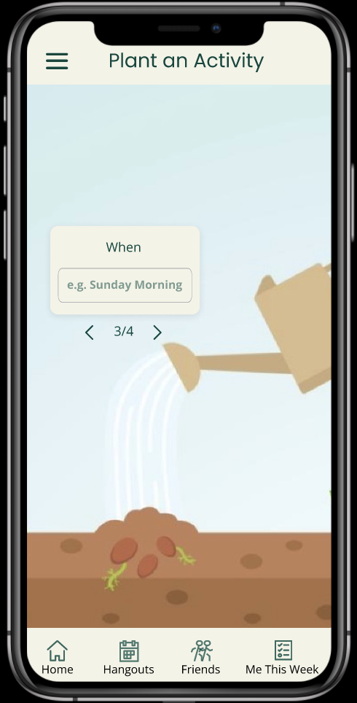
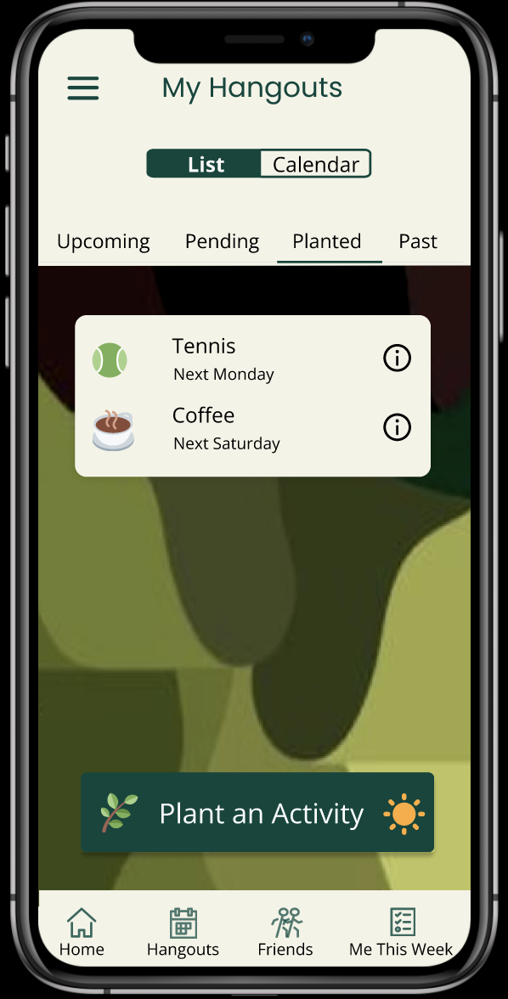
Task #3: Plant an Activity (2/2)

Slide 29
Task #4: Reflect on a Hangout

Slide 30




Task #4: Reflect on a Hangout (1/2)

Slide 31





Task #4: Reflect on a Hangout (2/2)

Slide 32

Design/Prototyping Tools: Figma
PROS
CONS
Real-time collaboration and editing
Extensive static screen building capabilities
Hierarchical formatting allows for easy grouping of components
Steep learning curve
Difficult to model animated or more interactive user interactions like toggling and typing
1. Figma was used to build medium-fi prototype

Slide 33

Design/Prototyping Tools: Canva
PROS
CONS
Helpful for initial inspiration and color generation
Difficult to translate from initial main color choices to finding an entire color suite that suits an app interface. i.e. Tool is not geared specifically towards artfully building user interfaces
1. Canvas was used for color palette mood boarding

Slide 34
Limitations
Not all buttons are clickable
Limited functionality beyond core tasks
No adding friend features
No initial onboarding process and general settings updates
No individual profile
Only allows interactions with fictional friends which are already added to the app
Automated hangout feature is hard-coded
Background image is low resolution
No integration with camera roll or external social media
Not all buttons link to other pages, e.g. the 'calendar' view on hangouts
Assumes photo integration

Slide 35
Wizard of Oz
Automated hangouts
Prototype automatically generates one hangout with you and a fictional friend Blake
No customization or implementation of a stable matching algorithm
Implementation is beyond the technical scope of a medium-fi prototype and will require the building out of a database first
Photo album integration
iOS and Android have different integrations, file types and upload systems, so we have left this out for now
Hard-coded generation of hangouts

Slide 36
Hard coded items
All information about friends and activities on the app are currently hard-coded
Photo uploads are also hard-coded
Fill in of forms happens automatically (i.e. no custom input of information)
Automatic generation of activity is hard-coded
We chose to hard code these components because this still allows for click through of all core tasks of the app, without needing to integrate a database or typable form features at this stage in the design process.
Example of hard-coded fill-in of form buttons. When you click on the component it leads to the next filled-in screen.

Slide 37
Figma Medium-fi Prototype
Link to Medium-fi Prototype

Slide 38
APPENDIX
Additional prototyping screenshots including additional features that are not a part of core tasks

Slide 39

Full Medium-fi Prototype (not wired)

Slide 40

Full Medium-fi Prototype (wired)

Slide 41

Static Settings
New static settings is easily accessible from the home screen but distinctly different from dynamic preferences–those updated weekly in new “Me this week” page

Slide 42

Past Hangouts Filter
Planning to implement ability to filter through past hangouts by friends, useful for wanting to see memories from hangouts with a particular friends (alternative to going through friend page to see past memories). Filtered UI depicted to the right

Slide 43




Activity Information
Additional information on hangouts accessible for Hiking with Blake and Planted Coffee Activity. Planning to implement this feature across listed hangouts in My Hangouts in future iterations

Slide 44

Alt Path: Accept a Hangout
When there is a pending activity, you can accept it from the home screen as an alternative to accepting it from the hangouts page. This is an important user tasks (accepting pending activities), which is why it is displayed on the home screen

Slide 45





Medium-fi Previous Iteration Snapshot
EXAMPLE SCREENS
We initially made a version of our medium-fi prototype that was more like our low-fi prototype in terms of layout and visual design. After completion, we felt that the visual aesthetic was dated and boring. Following this observation and receiving feedback from studio and lecture breakout rooms, we decided to pivot to a design that had a more modern aesthetic and incorporated more creative visuals and layouts.

